Slide 1
Evaluation of 6th Grade MTSS Processes and Procedures
Emily Makay
NCSLA
1

Slide 2
School History
NGMS is a low performing school. Teachers need to implement strong core instruction AND interventions to support all learners and promote growth and achievement.
2

Slide 3
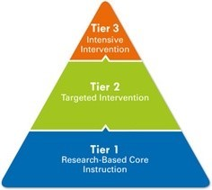
Problem of Practice
The goal is to provide professional development and support surrounding the tiers of instruction for the MTSS process in order to strengthen the instructional practices of teachers and show growth among students.
3

Slide 4
Evaluation Questions
Are we supporting professional learning?
Does our instructional framework guide curriculum, teaching, assessment, and the learning climate?
Do we provide targeted interventions?
4

Slide 5
The Data- Staff
All 6th grade teachers have 4 or less years of experience.
Three teachers are international teachers with 1 or less years of experience in the United States
One teacher is a first year teacher through Teach For America
5

Slide 6
The Data- Needs Analysis
Teachers were given a needs survey on professional development and potential topics.
64% of teachers indicated MTSS interventions as a P.D. need
83% of teachers asked for specific, implementable strategies
6

Slide 7
The Data- Reading and Math Proficiency
7

Slide 8
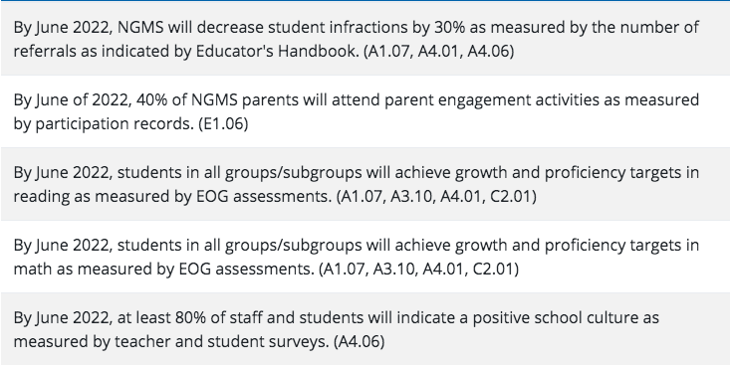
The Data- School Improvement Goals
Northern Granville is currently an “F” school.
The 6th grade reading GLP will need to increase from 34.1% to 44.1%
The 6th grade math GLP will need to increase from 31.9% to 41.9%
8

Slide 9
Intervention Data
NGMS does not receive detailed intervention logs from elementary schools within the district.
Many students who have been indicated as tier 2 or 3 students do not have up-to-date paperwork in their cumulative folders.
9

Slide 10
The Process
Whole staff, MTSS PD Sessions (3)
Data collection
IReady
Check In
Common Assessments
Data Focused PLCs
10

Slide 11
The Process
Intervention Planning
Intervention Groups
MTSS Meetings
Reflection
11

Slide 12
Progression
Gradual release of PLC lead
Began the year choosing topics, leading the discussion and providing support
Started asking for teacher input on topics
Stayed strong with PLC expectations
12

Slide 13
Progression
MTSS Meetings
Teachers began unprepared and confused
Paperwork hadn’t been completed, they didn’t know what to expect
Teacher preparation greatly improved meeting #2
Paperwork was completed weekly
Student advocacy increased
13

Slide 14
Findings
Teachers need professional development on the processes and practices surrounding MTSS.
Do not assume everyone’s understandings are the same
Stress the importance and effectiveness
Build the passion!
14

Slide 15
Findings
Expectations should be clear and well communicated
Consistency across grade levels
Timely
Supported
15

Slide 16
Recommendations
1- Continued Professional Development
Prepare “new teacher MTSS orientation” PD to give yearly to staff new to NGMS.
Provide PD for extending understanding and implementation of MTSS processes for returning staff
16

Slide 17
Recommendations
2- Collection of Intervention Materials
Teachers seem uncertain of what counts as an intervention.
Teachers find it time consuming to gather additional materials.
17

Slide 18
Recommendations
3- Streamlining MTSS Processes
The paperwork process can be easily misinterpreted.
The review meetings are time consuming.
18

Slide 19
Reflection
Teachers appreciate honesty about the difficulties in implementing a strong MTSS process.
Scaffolding encourages teachers to participate and allows them to practice reviewing data effectively.
19

Slide 20
Reflection
Supporting teachers when planning and implementing interventions builds teacher capacity for successful interventions.
Thank you!
20

